Slide 1
Hash Function in C-Programming

Slide 2
What is hashing?
Hashing is the process of converting a given key into another value.

Slide 3
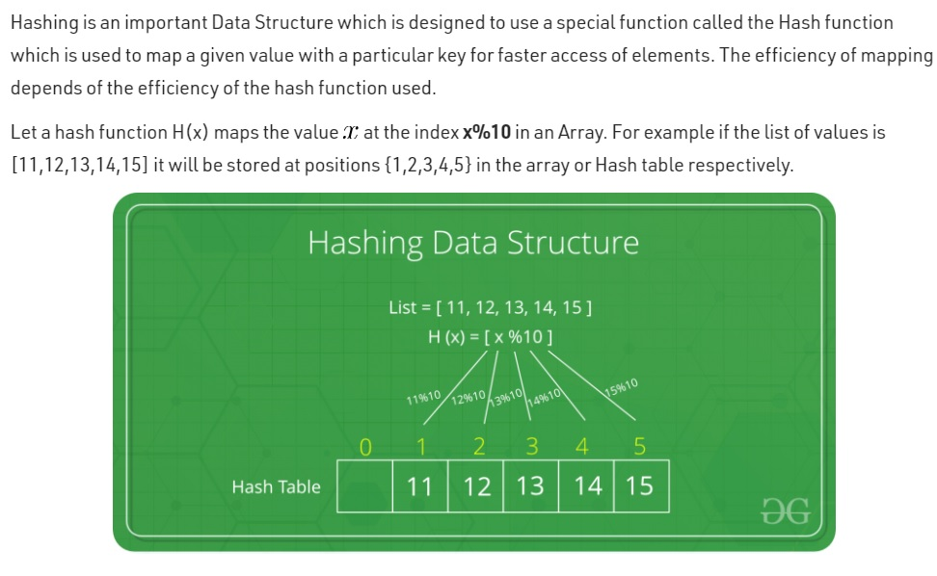

Slide 4
Types of hashing….
Types of a Hash Function In C
Division method. In this method, the hash function is dependent upon the remainder of a division. ...
Mid Square Method. In this method, the middle part of the squared element is taken as the index. ...
Digit Folding Method.

Slide 5
Types of Collision Resolution Techniques
Chaining
Open Addressing

Slide 6
Disadvantages of Hasing?
Hash collisions are practically unavoidable. when hashing a random subset of a large set of possible keys.
Hash tables become quite inefficient when there are many collisions.
Hash table does not allow null values, like hash map.

Slide 7
Why do we use hashing?
Main advantage is synchronization.
In many situations, hash tables turn out to be more efficient than search trees or any other table lookup structure. For this reason, they are widely used in many kinds of computer software, particularly for associative arrays, database indexing, caches and sets.

Slide 8
THANK YOU
Under Supervision of:-
Mrs. Rajeshwari
(Asst. Professor)
Made By :-
Ankit Singh 1JS19cs027
Deepak Naidu 1JS19CS049
Chirag Verma 1JS19CS046

